Slide 1
CSC 335 PODCAST PLAYER
By Nathan Teku, Michael Stark, Kyle Clements, Tinnawit Mangkang

Slide 2
Introduction
For the final project of CSC 335, we chose to do the podcast player
We all love podcasts with a passion as we overall had a lot of fun creating this project because podcasts are a daily part of our lives

Slide 3
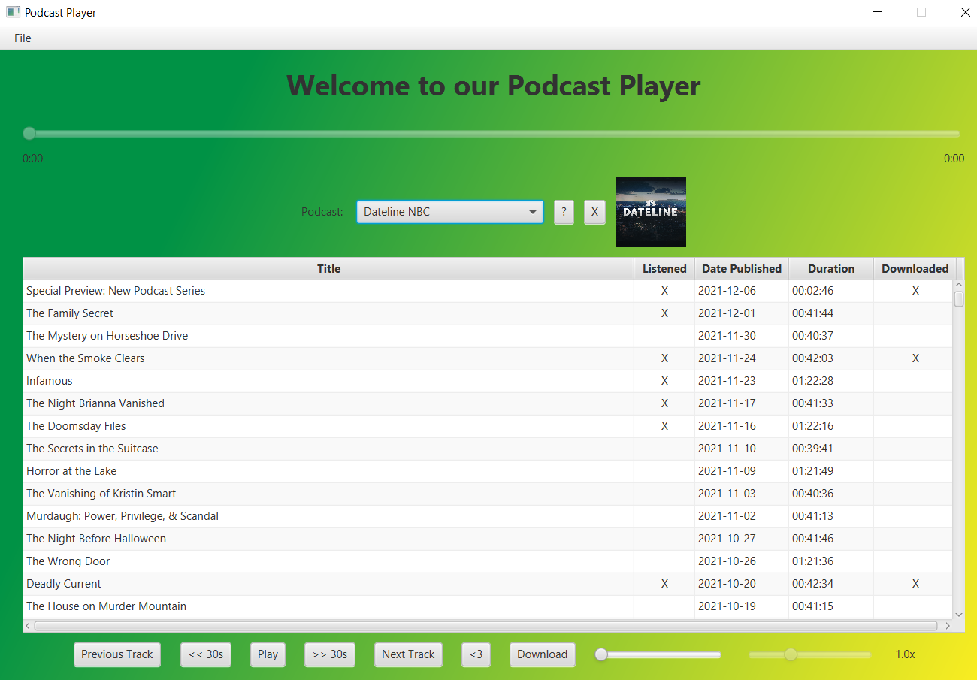
View
This is the Overall View of our Podcast Player
It contains basic UI Components such as Play, Previous Track, Next Track, etc.
Contains a progress bar
Has a Feed
Determines if an Episode is either Listened to or Downloaded
Checks the Duration and Date Published

Slide 4
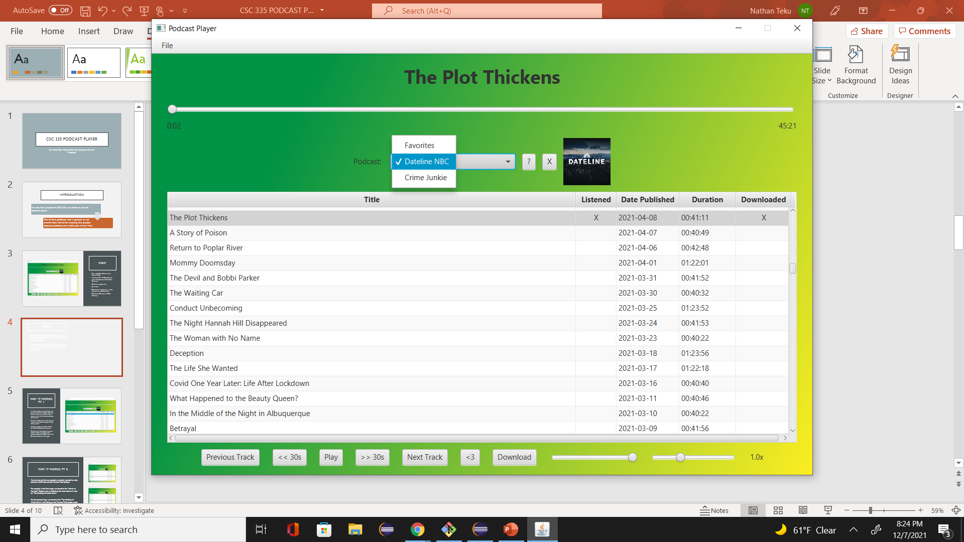
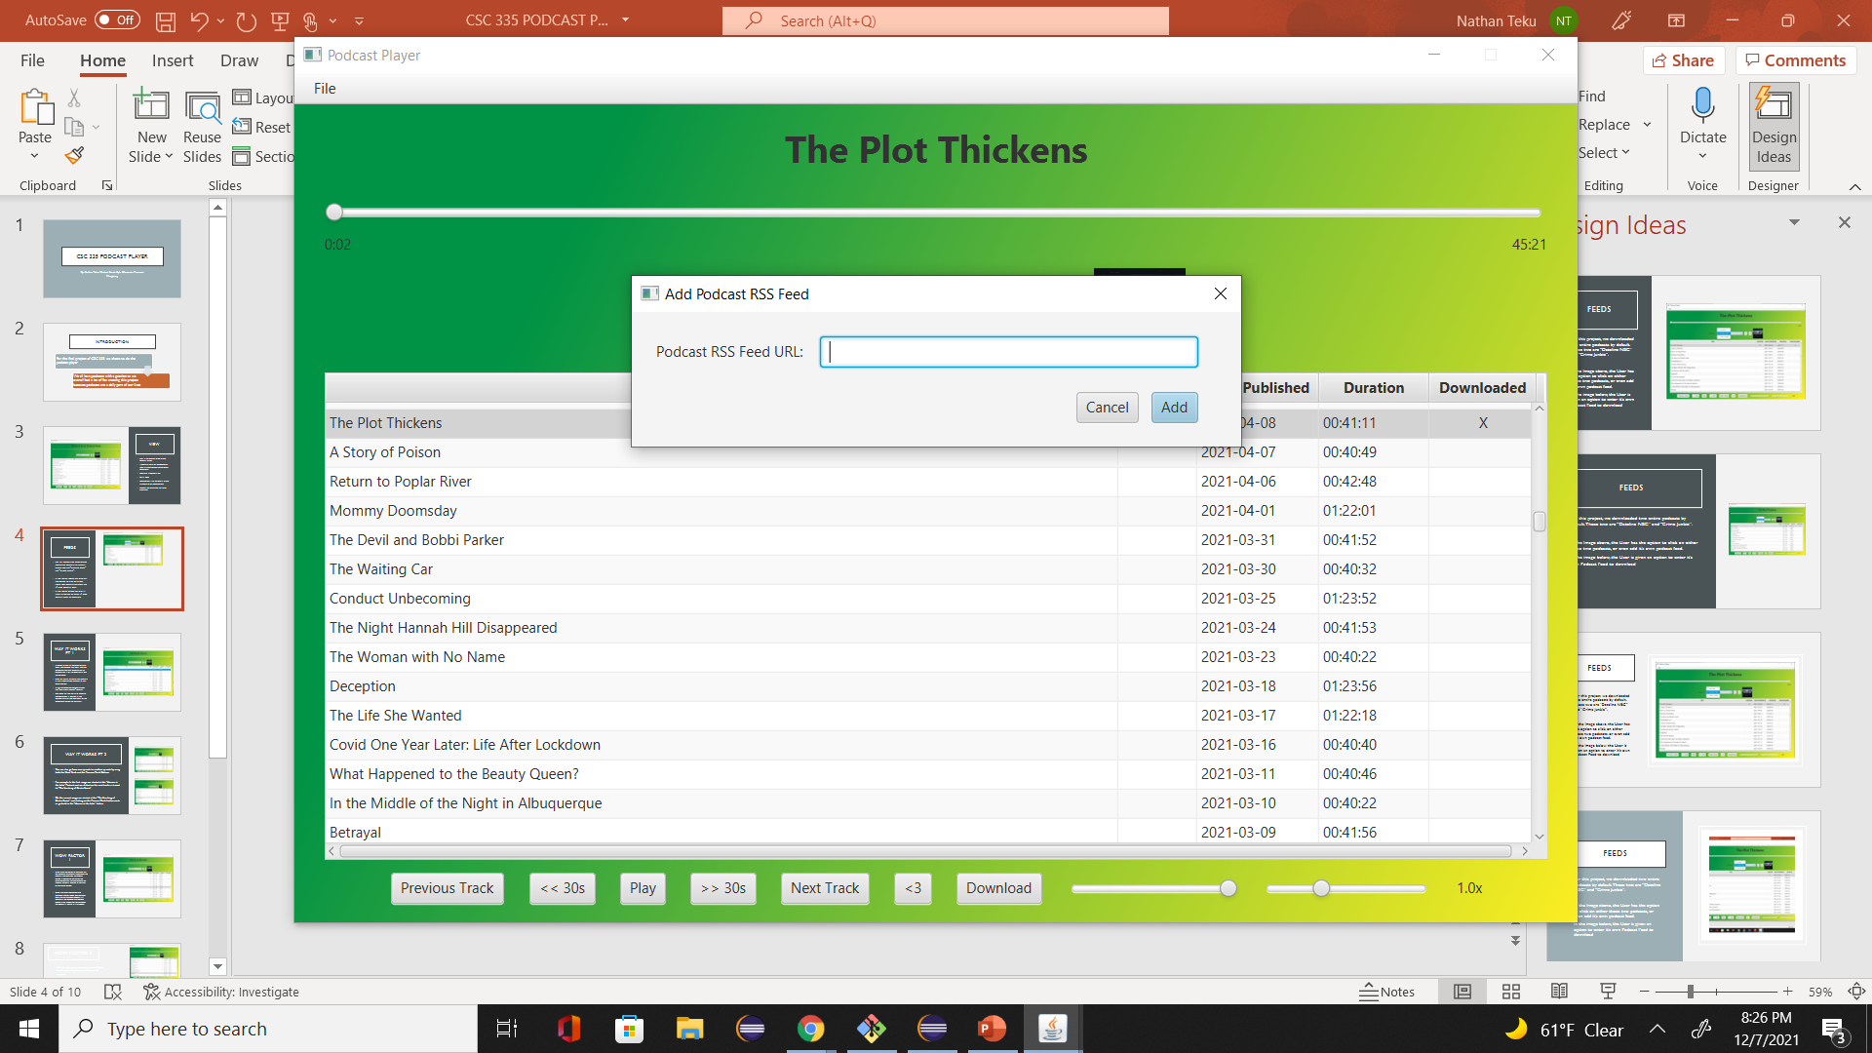
FEEDS
For this project, we downloaded two entire podcasts by default. Those two are “Dateline NBC” and “Crime Junkie”.
In the Image above, the User has the option to click on either those two podcasts, or even add its own podcast feed.
In the image below, the User is given an option to enter its own Podcast Feed to download

Slide 5
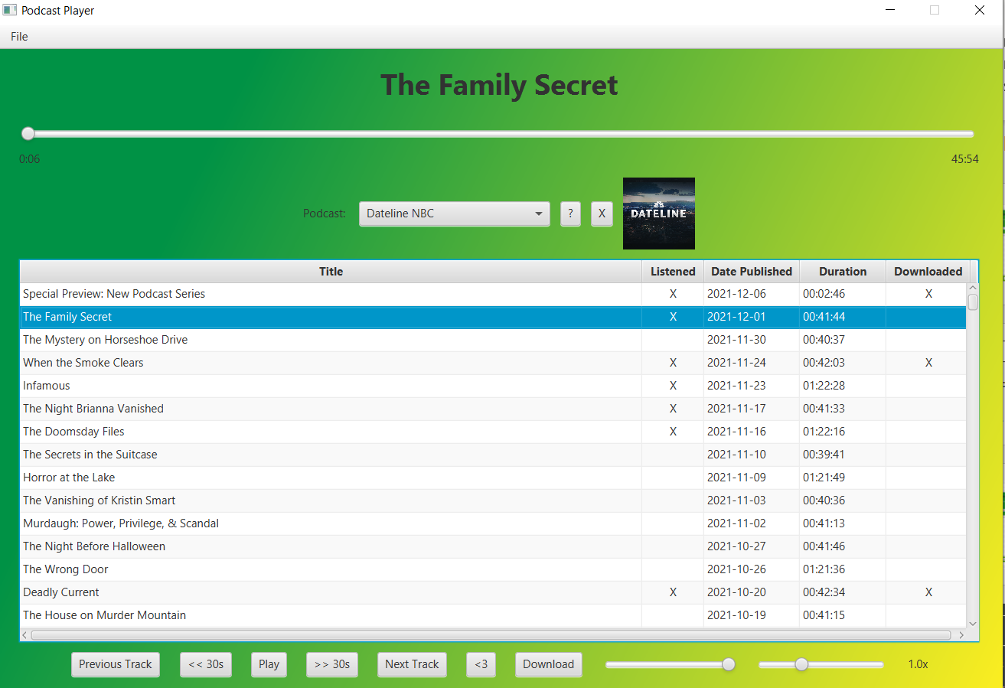
Way It works PT 1
In order to play an episode, you can press the episode and press the play button, or you can double click an episode and it will automatically play the episode.
User has ability to pause the podcast, as that same button changes to play when paused.
In this example, we double clicked the “The Family Secret” podcast
The User can increase volume, which is located at the bottom right of the GUI, next to the Download button to the right.

Slide 6
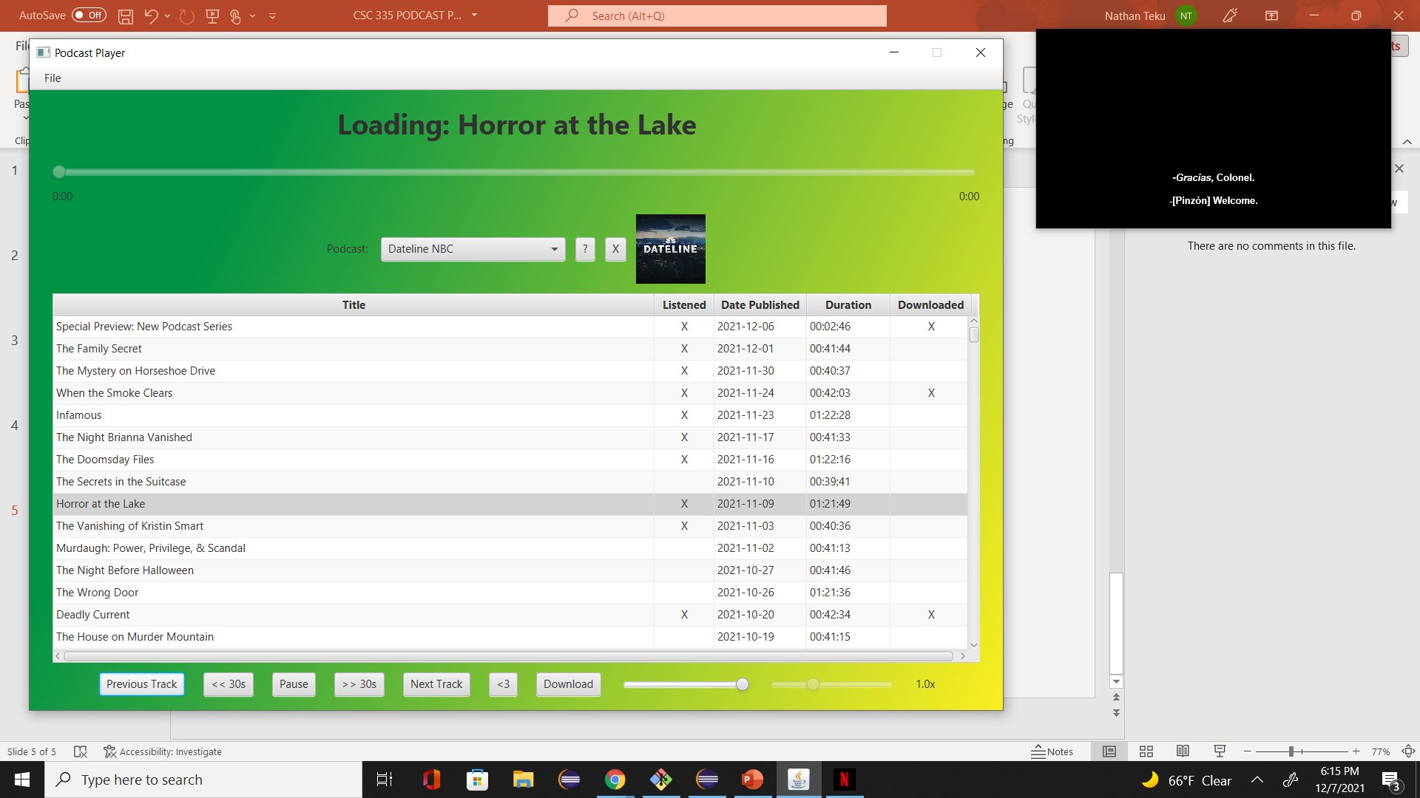
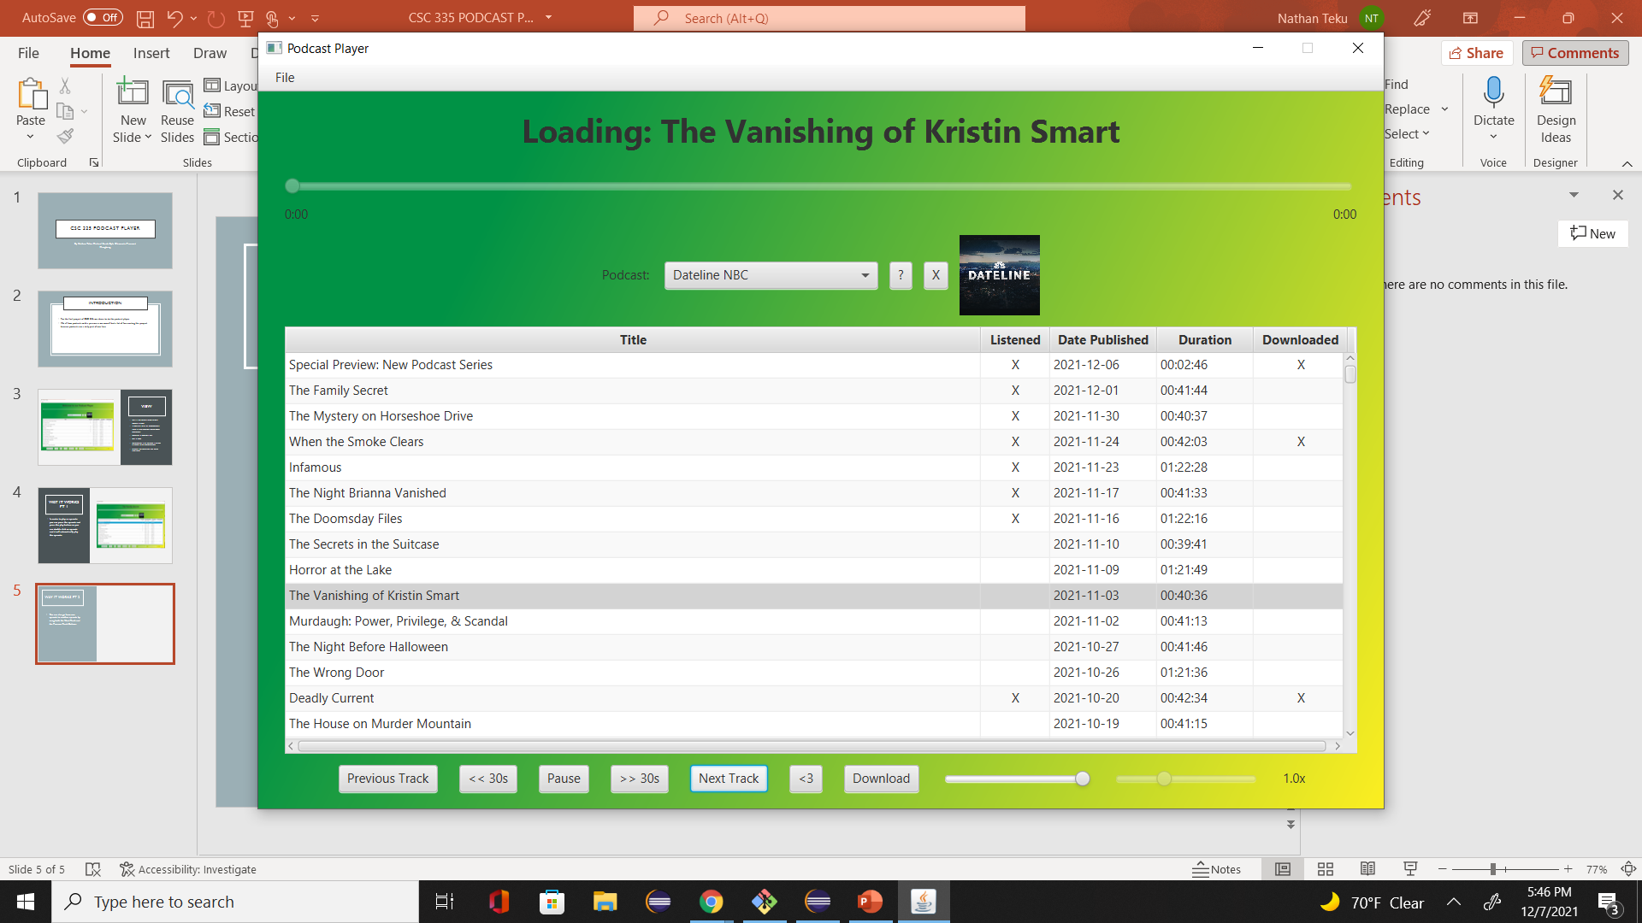
Way it works pt 2
You can also go from one episode to another episode by using both the Next Track and the Previous Track Buttons
For example, In the first image, we started at the “Horror at the Lake” Podcast, and we clicked on the next track as it went to “The Vanishing of Kristin Smart”
On the second image, we started at the “The Vanishing of Kristin Smart” and clicking on the Previous Track button made us go back to the “Horror at the Lake” button

Slide 7
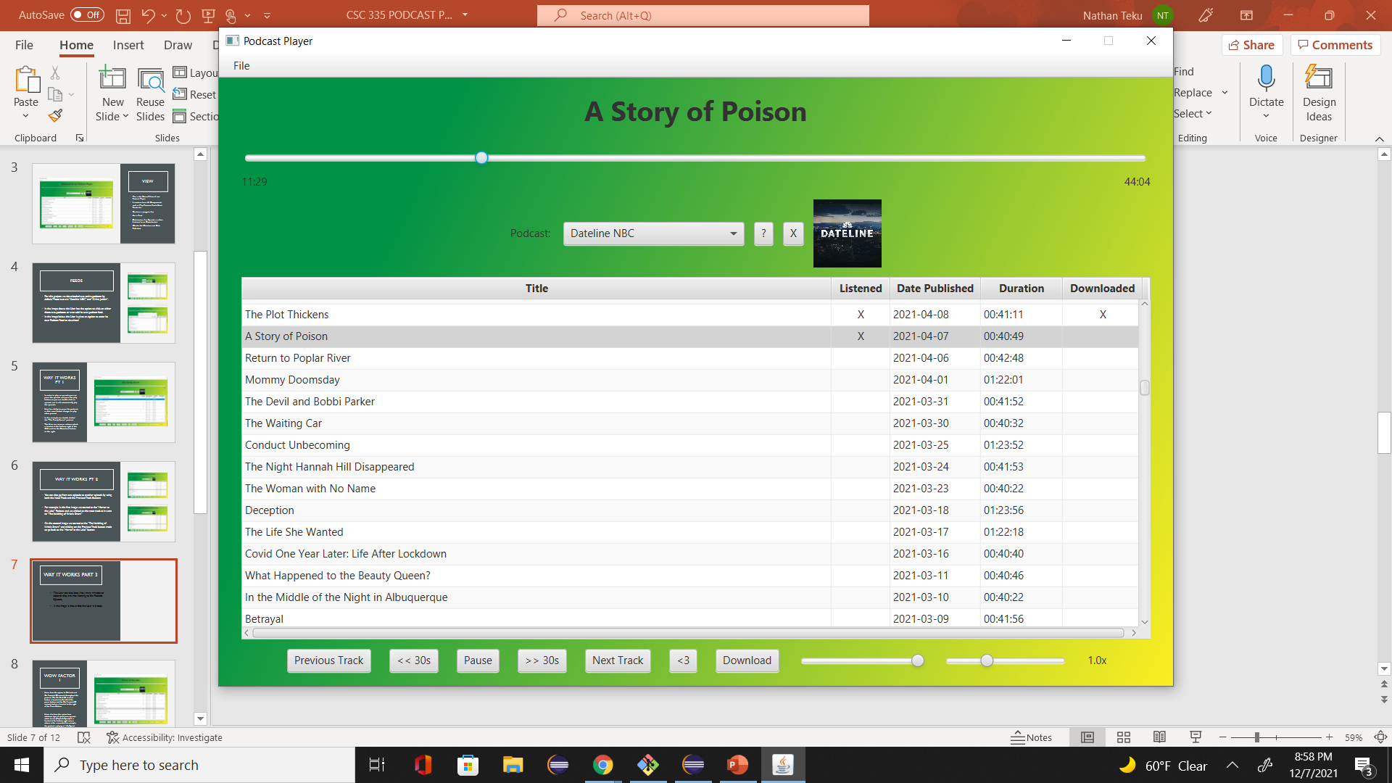
Way it works part 3
The User can also know how many minutes or seconds they are into listening to the Podcast Episode.
In the image, it shows that the User is already 11 minutes and 29 seconds in the “A Story of Poison” episode from Dateline.

Slide 8
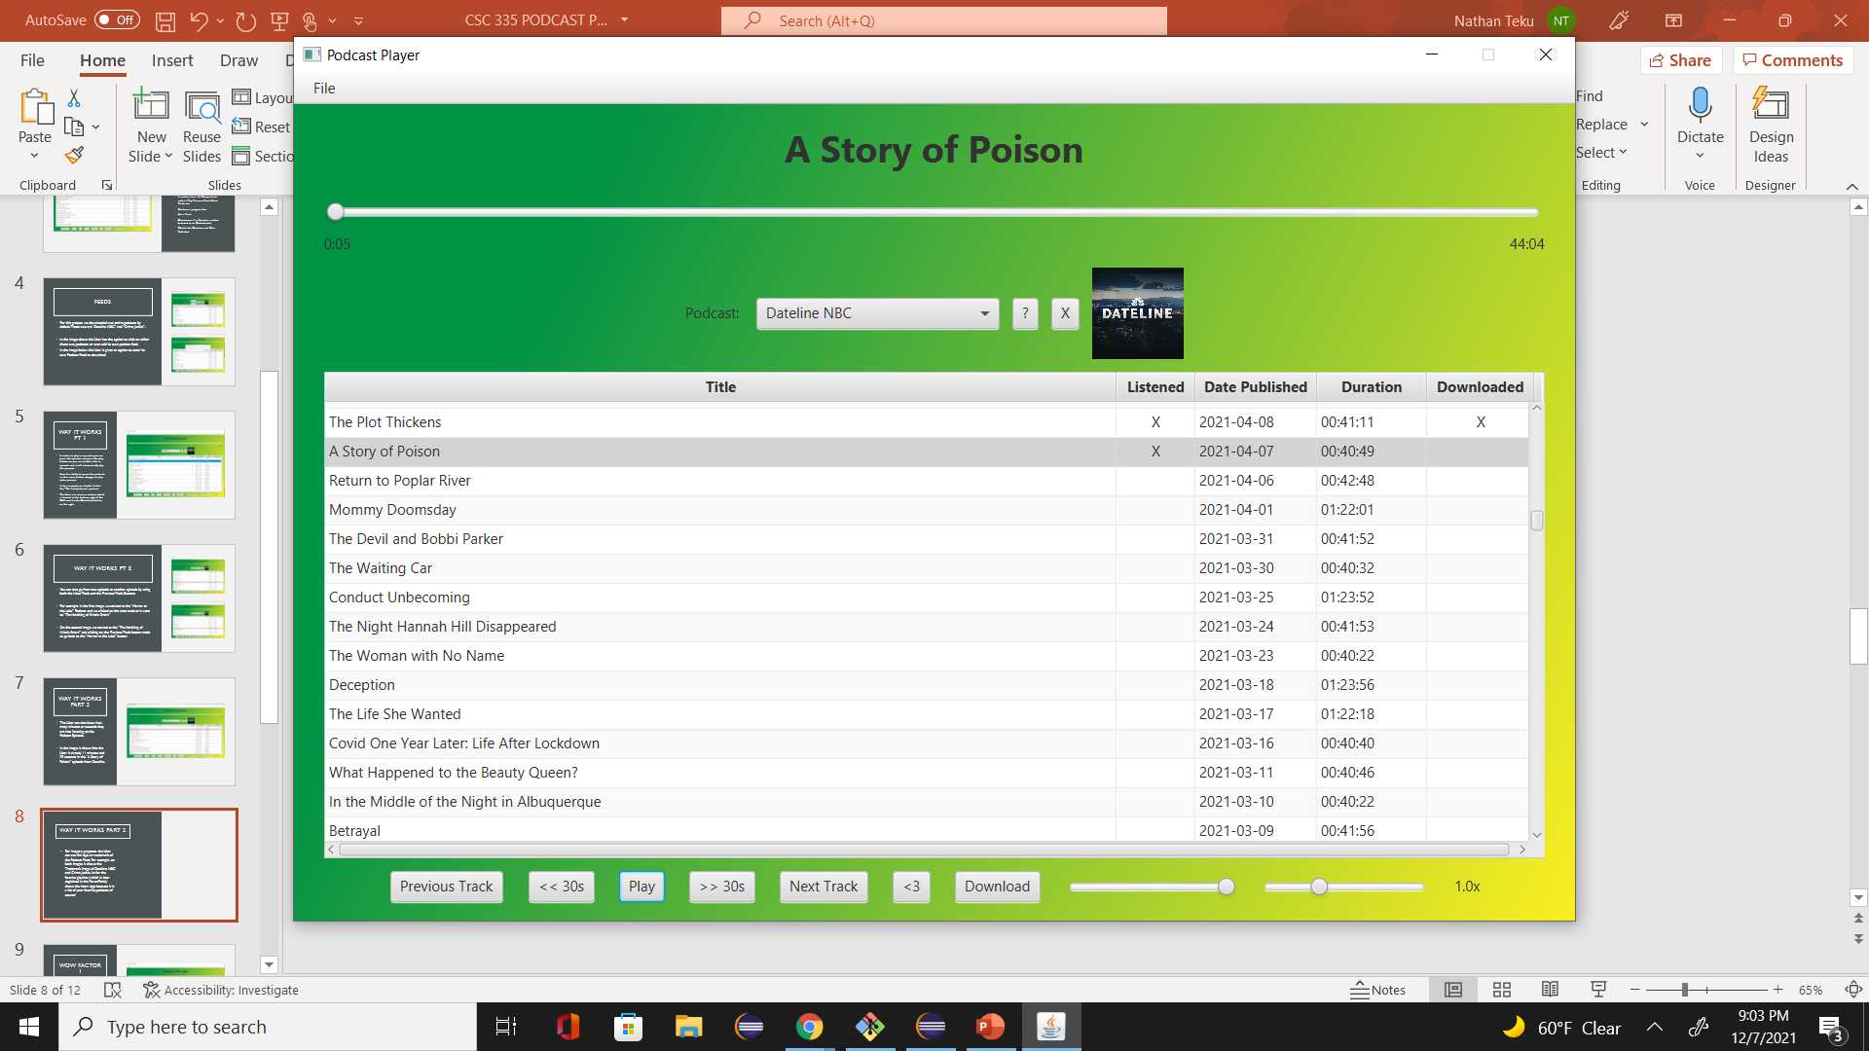
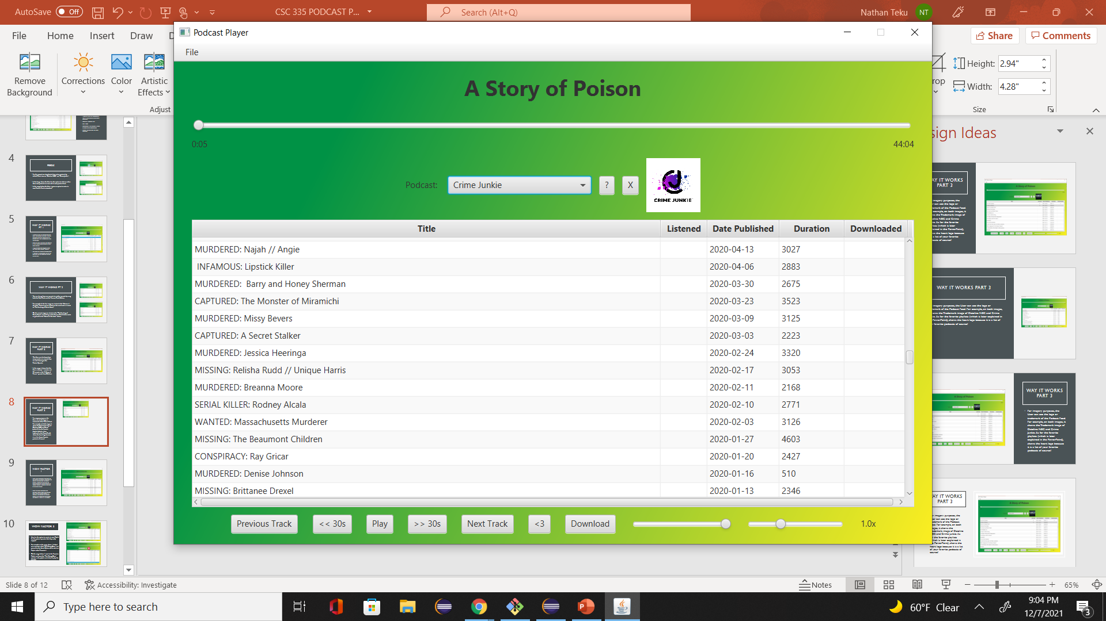
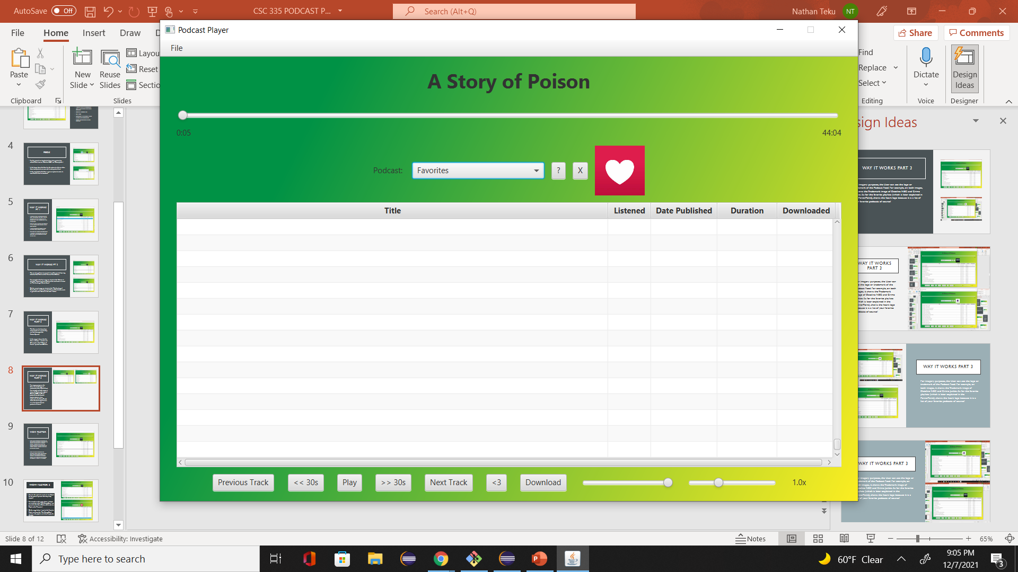
Way it works part 3
For imagery purposes, the User can see the logo or trademark of the Podcast Feed. For example, on both images, it shows the Trademark image of Dateline NBC and Crime Junkie. As for the favorite playlists (which is later explained in the PowerPoint), shows the heart logo because it is a list of your favorite podcasts of course!

Slide 9
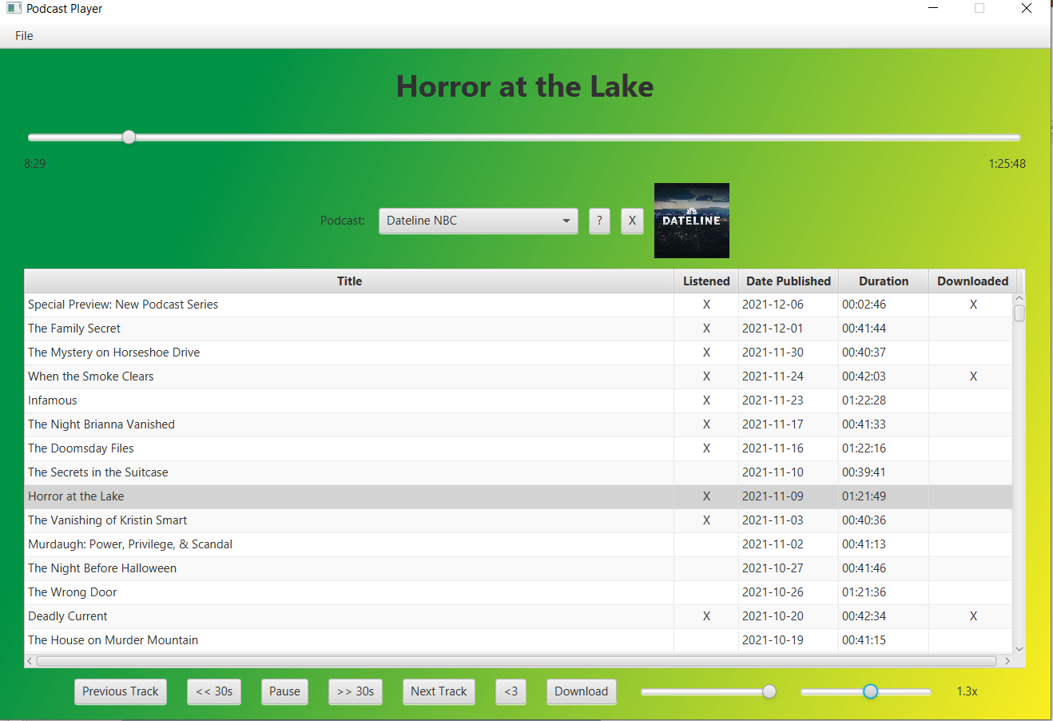
WOW factor 1
Users have the option to Go back and Go Forward 30 seconds throughout the podcast. The Go Back 30 seconds button is located to the left of the pause button, and the Go Forward 30 seconds button is located to the right of the Pause Button.
Users also have the option have whatever type of speed your episode whats to run (Playback Speed). It is located at the bottom right corner, where in the screenshot for example, the podcast is playing at 1.3x Speed.

Slide 10
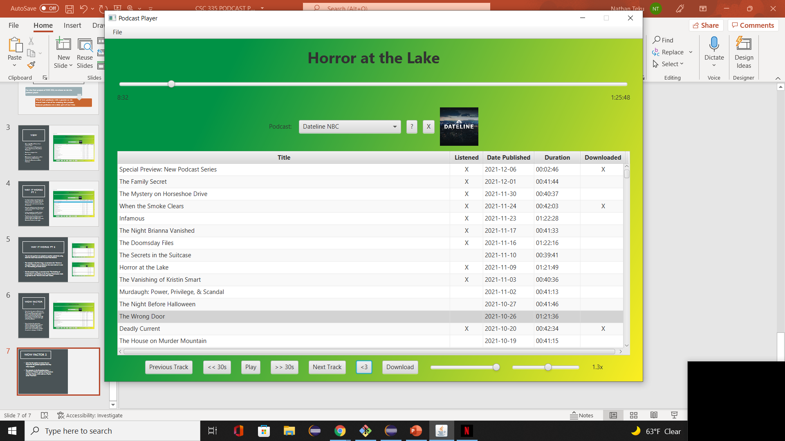
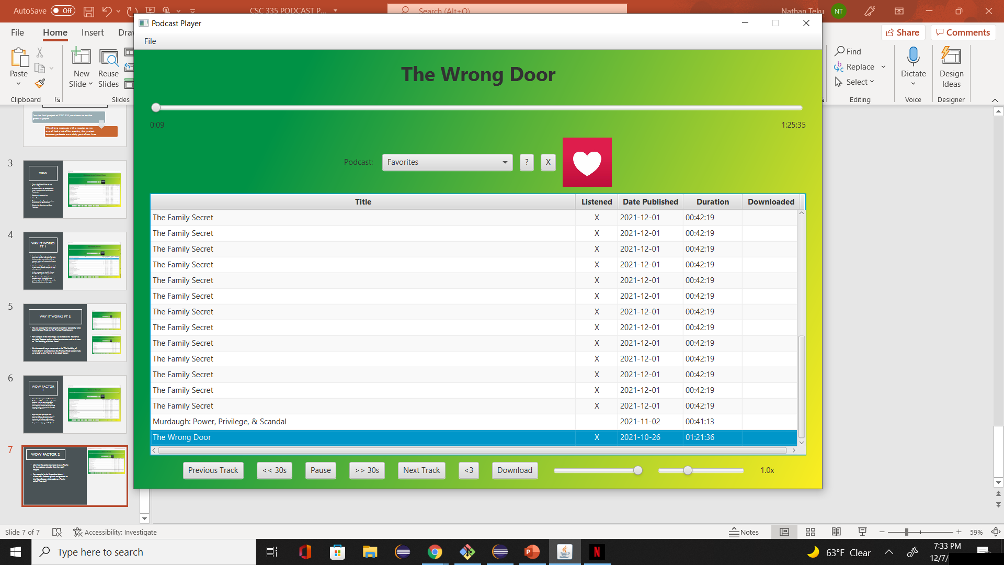
Wow factor 2
User has the option to create its own Playlist for the podcast episodes that they really enjoyed.
For example, on the image above, I clicked on an episode called “The Wrong Door” and pressed on the Heart Button which adds to a Playlist called “Favorites”.
On the image below, I went to the Favorites Playlist and found the “The Wrong Door” episode in the playlist and clicked to play the episode.

Slide 11
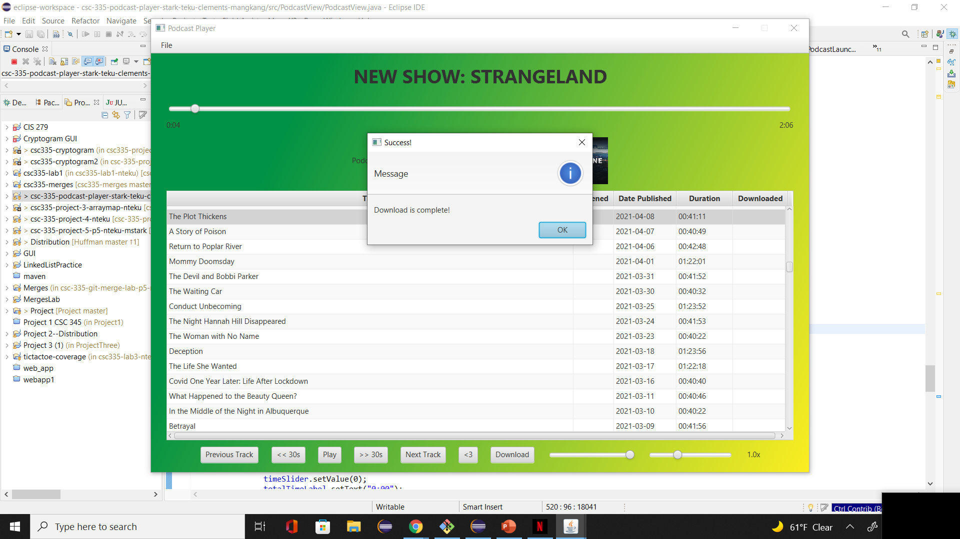
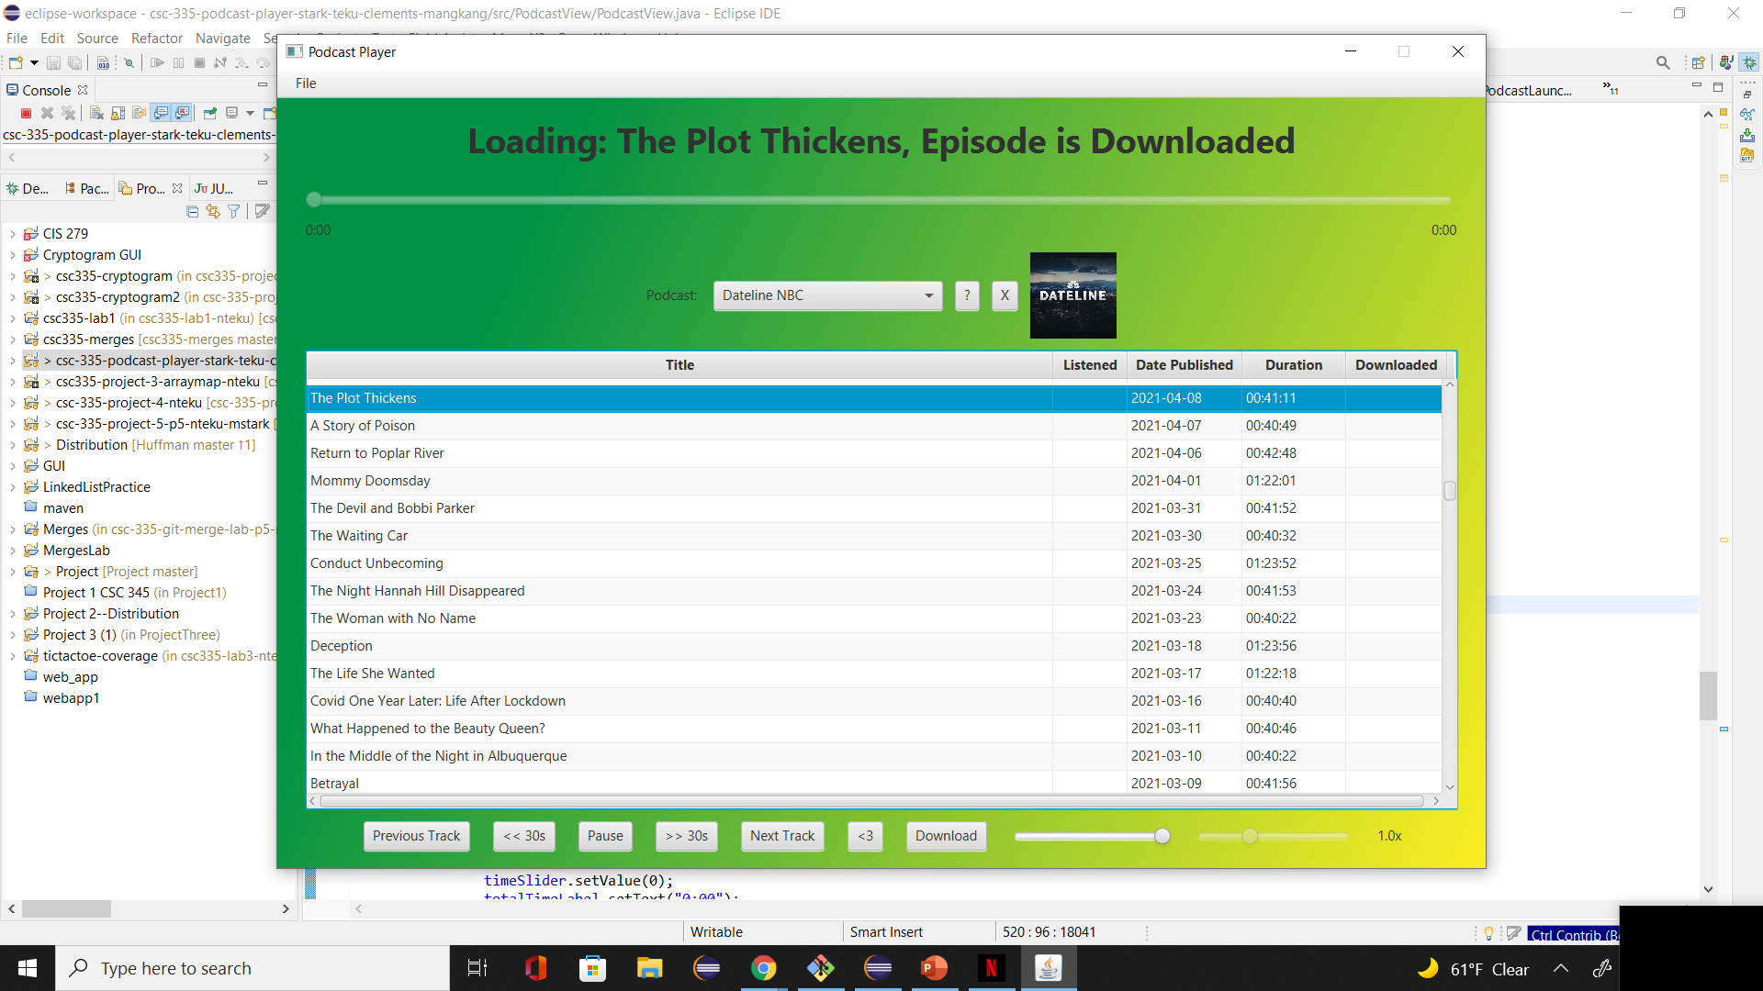
Wow factor 3
User has the option to download a specific podcast episode they like.
For example, in the image above, we select the podcast episode “The Plot Thickens” and press the download button. If it successfully downloaded the file, a pop-up window lets the user know it has been successfully downloaded.
On the image below, when wanting to play the “The Plot Thickens” episode, it lets the user know when loading, that it is a downloaded episode.

Slide 12
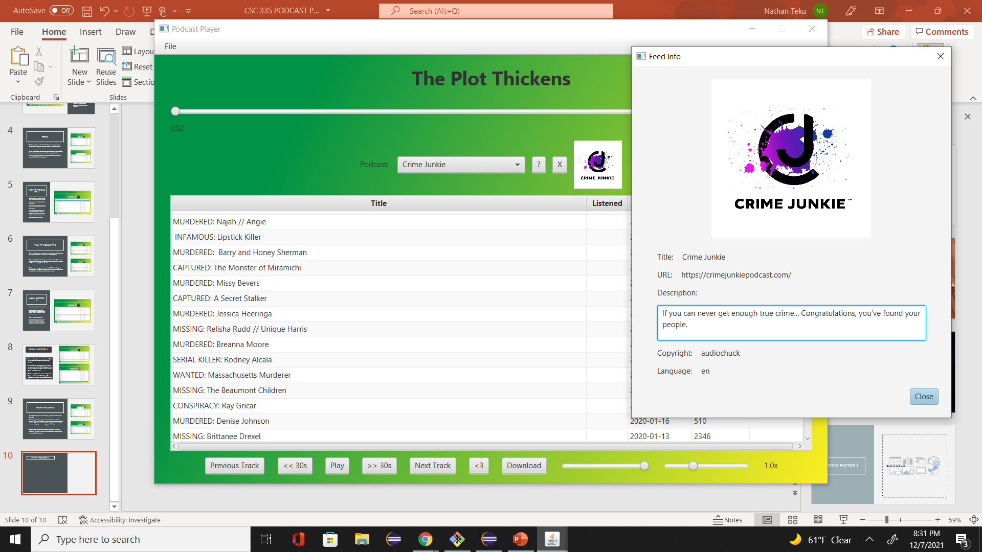
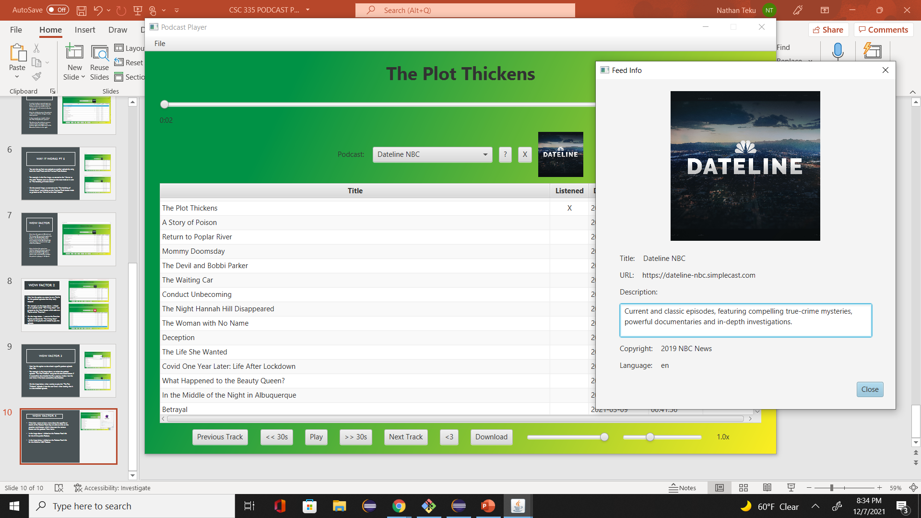
Wow factor 4
If the User wants to know more about the specifics or details of the Podcast Feed, they are able to click on the question mark button which is between the remove button and the podcast Menu Items.
In the image above, I clicked on the Podcast Feed Info for the Crime Junkie Podcast.
In the image below, I clicked on the Podcast Feed Info for the Dateline NBC Podcast.

Slide 13
THE END (WE HOPE YOU ENJOY OUR PROJECT!)

